Slide 1
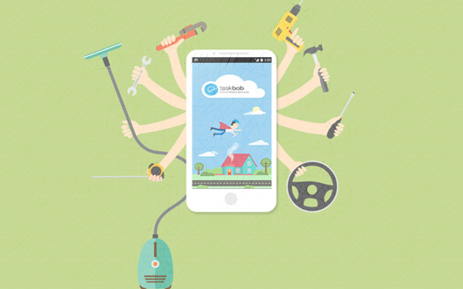
Home helper service’s
We care about your time and handle your work

Slide 2

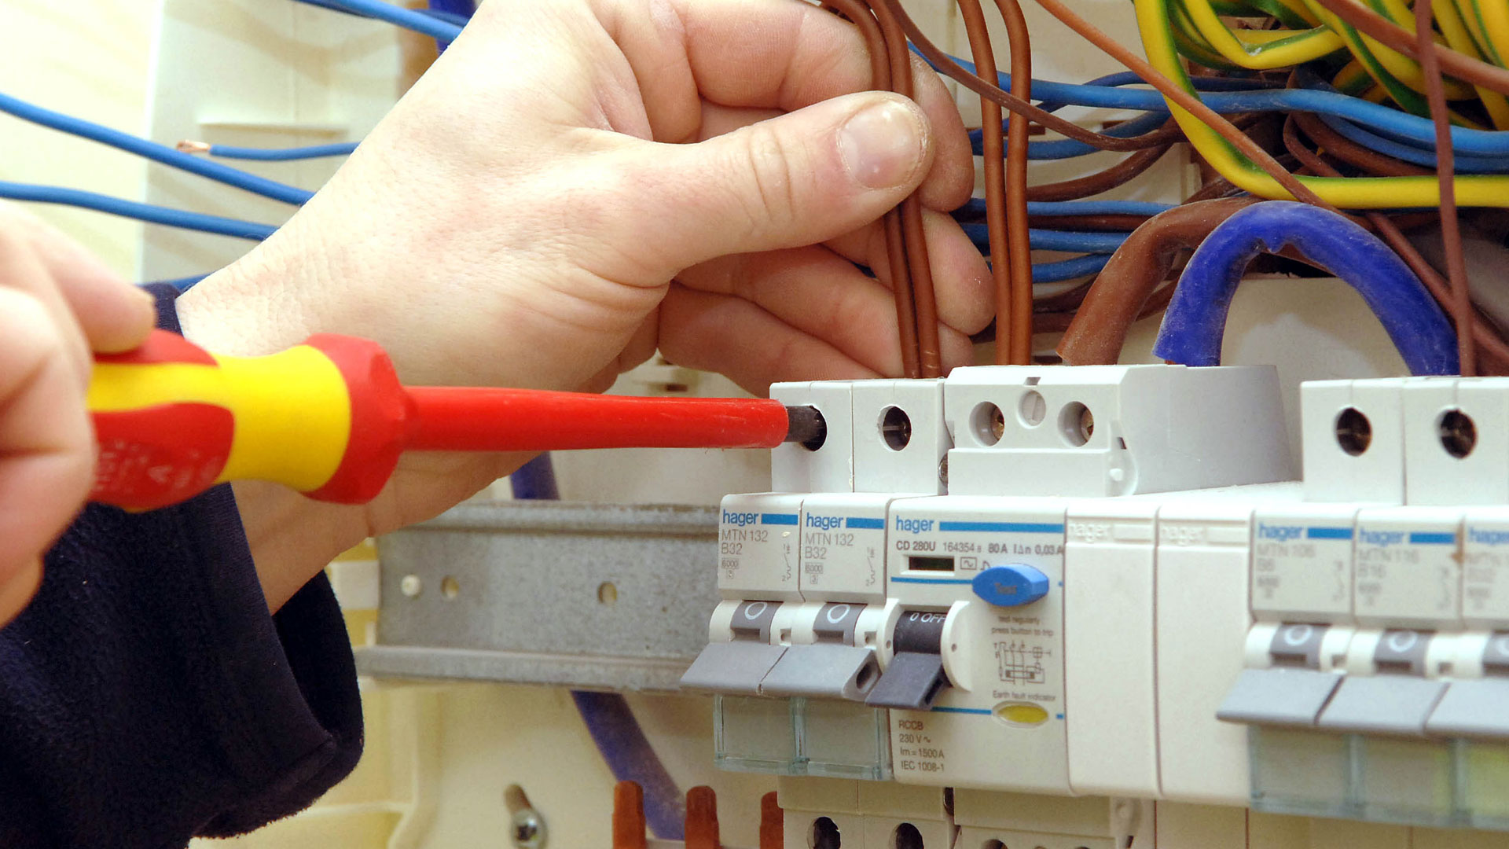

Our services: -
Electrician.
Plumber.
House cleaning.
Carpenter.
Painters.
Men’s and women’s salons.
Toilet and bathroom cleaning services.

Slide 3
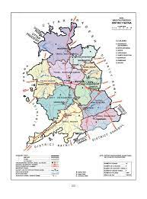
Market potential: -
Total population of Satna city according To 2021 is 280,222. in which the literacy rate is 74.9%.
8th populated city in the state.
It is also called the commercial capital city of Bundelkhand.
Almost every home needs these services once
a month.

Slide 4
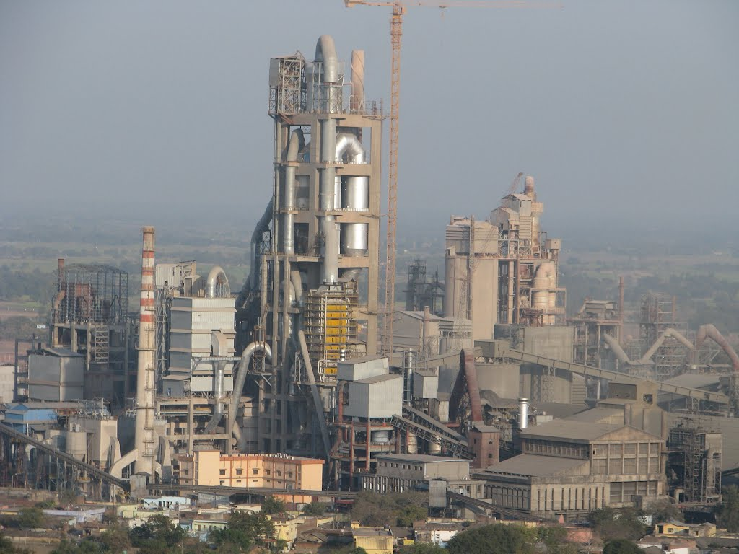

Our target consumers: -
Our target consumers are middle-class and higher-middle-class families in the city.
Collaboration with companies and offices to provide them with our services.
Satna is a developing city so focus on developing projects, collages and schools.

Slide 5
Profit for the business: -
Get work and give to different field workers and get a 10 – 15 % margin on every work assigned.
collaborate with the shops for assignable and low-priced products.

Slide 6
Our goals: -
Establishment of business.
Launch of website and application.
Capture the market of Satna before 2025.
Expansion to other cities.

Slide 7
Our questions for Satna incubation center: -
Assessment of our business.
How to do market Analysis?
How to register a start-up?
Guide to our path from time to time and become part of this incredible journey.

Slide 8
Thanks
for
listening

